Slide 1
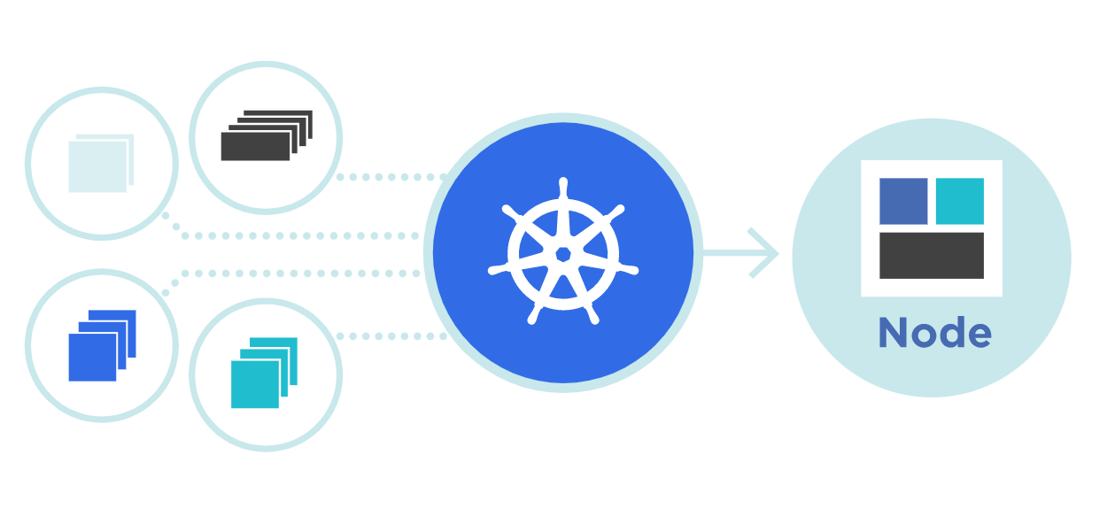



Cgroup & Namespace
Theory + LAB + Documents ➔ All free
WATCH NOW

Slide 2


Worker node 1 / VM
Master node 1 / VM
Schedular
POD 1
C: webapp1
Kubelet
API Server
Etcd Database
Kube-Proxy
POD 2
C: database1
Controller
Kubernetes
Kubernetes
Docker Engine
Docker Engine
CentOS 9
CentOS 9

Slide 3
Questions
How are these containers can access the Hardware resources?
How POD’s PIDs are separated to other pods?
cgroup
Namespace

Slide 4
cgroup

Slide 5
cgroup
A control group (CGroup) is a Linux kernel feature that allocates, limits and isolate the resource usage for CPU, memory, network and Disk.
In a Kubernetes environment, cgroups can be used to implement resource requests and limits and corresponding QoS classes at the pod level.
[root@master1 ~]# ls -ltr /sys/fs/
drwxr-x--- 2 root root 0 Nov 22 08:29 pstore
dr-xr-xr-x 2 root root 0 Nov 22 08:29 selinux
drwxr-xr-x 3 root root 0 Nov 22 08:29 fuse
dr-xr-xr-x 12 root root 0 Nov 22 08:33 cgroup
drwx-----T 3 root root 0 Nov 22 08:38 bpf
drwxr-xr-x 5 root root 0 Nov 22 18:33 xfs
[root@master1 ~]#

Slide 6
Hardware
N/W
CPU
RAM
HD
Linux Kernel
Cgroup
04
Linux Kernel
It has multiple core components, like Cgroup
CRI
CRI
03
Containerd
The container runtime (CRI) is the software that is responsible for running containers.
Kubelet
Kubelet
02
Kublet uses containerd daemon or probably runc, lxc, rkt and cri-o through CRI
POD
POD
01
It actually run the container
Basic understanding of Cgroup

Slide 7
Namespace

Slide 8
Namespace
What is namespace?
In Linux, namespaces have been a part since 2002 and over the time, more namespaces have been added in Linux kernel.
Container support namespaces, added in 2013.
With the help of namespaces, we can partition kernel resources. Which means that one process can sees one set of resources and other process one set of resources only.
We can say that it isolate the processes from each other. There are different types of namespaces, such as User, Mnt, UTS, IPC, PID and Net.

Slide 9
1
4
5
6
7
8
51
52
53

Slide 10
Hardware
N/W
CPU
RAM
HD
Basic understanding of Namespace
Namespace
Linux Kernel
04
Linux Kernel
It has multiple core components, Namespace
CRI
PID
CRI
03
Containerd
The container runtime (CRI) is the software that is responsible for running containers.
Kubelet
Kubelet
02
Kublet uses containerd daemon or probably runc, lxc, rkt and cri-o through CRI
POD
POD
01
It run the container
Notes:
You can download this template from https://slidehunter.com/

Slide 11
How to find the running process ID of container?

Slide 12
[root@master1 ~]# docker container run alpine ping 8.8.8.8
[root@master1 ~]# ps aux | grep ping
root 290750 0.0 1.6 1264864 37500 pts/0 Sl+ 15:35 0:00 docker container run alpine ping 8.8.8.8
root 290794 0.0 0.0 1600 4 ? Ss 15:35 0:00 ping 8.8.8.8
root 294725 0.0 0.0 221796 2236 pts/1 S+ 15:41 0:00 grep --color=auto ping
[root@master1 ~]# lsns –p 290750
NS TYPE NPROCS PID USER COMMAND
4026531834 time 185 1 root /usr/lib/systemd/systemd rhgb --switched-root --system --deserialize 31
4026531835 cgroup 177 1 root /usr/lib/systemd/systemd rhgb --switched-root --system --deserialize 31
4026531836 pid 150 1 root /usr/lib/systemd/systemd rhgb --switched-root --system --deserialize 31
4026531837 user 184 1 root /usr/lib/systemd/systemd rhgb --switched-root --system --deserialize 31
4026531838 uts 175 1 root /usr/lib/systemd/systemd rhgb --switched-root --system --deserialize 31
4026531839 ipc 150 1 root /usr/lib/systemd/systemd rhgb --switched-root --system --deserialize 31
4026531840 net 177 1 root /usr/lib/systemd/systemd rhgb --switched-root --system --deserialize 31
4026531841 mnt 136 1 root /usr/lib/systemd/systemd rhgb --switched-root --system --deserialize 31
Other way to find the running PID of container?
[root@master1 ~]# docker container ps
CONTAINER ID IMAGE COMMAND CREATED STATUS PORTS NAMES
750b8cb55593 alpine "ping 8.8.8.8" 6 minutes ago Up 6 minutes hungry_hopper
[root@master1 ~]# docker inspect 750b8cb55593 | grep -i PID
"Pid": 290794,
"PidMode": "",
"PidsLimit": null,
[root@master1 ~]#

Slide 13
[root@master1 ~]# docker container run alpine ping 8.8.8.8
[root@master1 ~]# ps aux | grep ping
root 290750 0.0 1.6 1264864 37500 pts/0 Sl+ 15:35 0:00 docker container run alpine ping 8.8.8.8
root 290794 0.0 0.0 1600 4 ? Ss 15:35 0:00 ping 8.8.8.8
root 294725 0.0 0.0 221796 2236 pts/1 S+ 15:41 0:00 grep --color=auto ping
[root@master1 ~]# lsns –p 290750
NS TYPE NPROCS PID USER COMMAND
4026531834 time 185 1 root /usr/lib/systemd/systemd rhgb --switched-root --system --deserialize 31
4026531835 cgroup 177 1 root /usr/lib/systemd/systemd rhgb --switched-root --system --deserialize 31
4026531836 pid 150 1 root /usr/lib/systemd/systemd rhgb --switched-root --system --deserialize 31
4026531837 user 184 1 root /usr/lib/systemd/systemd rhgb --switched-root --system --deserialize 31
4026531838 uts 175 1 root /usr/lib/systemd/systemd rhgb --switched-root --system --deserialize 31
4026531839 ipc 150 1 root /usr/lib/systemd/systemd rhgb --switched-root --system --deserialize 31
4026531840 net 177 1 root /usr/lib/systemd/systemd rhgb --switched-root --system --deserialize 31
4026531841 mnt 136 1 root /usr/lib/systemd/systemd rhgb --switched-root --system --deserialize 31
Other way to find the running PID of container?
[root@master1 ~]# docker container ps
CONTAINER ID IMAGE COMMAND CREATED STATUS PORTS NAMES
750b8cb55593 alpine "ping 8.8.8.8" 6 minutes ago Up 6 minutes hungry_hopper
[root@master1 ~]# docker inspect 750b8cb55593 | grep -i PID
"Pid": 290794,
"PidMode": "",
"PidsLimit": null,
[root@master1 ~]#

